Slide 1

CLCS Evening Language Modules
Broad Curriculum & Extracurricular
Orientation

Slide 2
Modules: 10 things
Autonomy
Attendance
Broad Curriculum
Communication
Project work
Groupwork
Homework
European Language Portfolio
Assessment
Multimedia resources

Slide 3
1. Language Learner Autonomy
Responsible for your own work, planning
Not school; not a grammar class; not a conversation class
Self-monitoring, self-reflection
Successful language learners are autonomous language learners
Communicative proficiency in a study or work context, we want you to be able to use the language for your own needs and purposes

Slide 4
2. Attendance
Compulsory attendance for all students
Poor attendance: you will lose your place
Long waiting list
Groupwork – keep in touch with your group, let them know of your absences so they can plan groupwork
Absent? Contact your teacher/the CLCS office by email
Broad Curriculum students who fail to attend regularly will be returned as non-satisfactory (NS) according to College regulations – in other words, your language module is part of your degree course.
Keep in touch with our office, clcsinfo@tcd.ie, submit med certs etc.

Slide 5
3. Broad Curriculum
For range of courses, part of the Broad Curriculum. This means that it is part of your degree course, will appear on your transcript and will contribute to your end of year overall mark
Must complete both terms and all coursework/exam to obtain 5 credits
Some of you will be taking this as an optional, extracurricular course – you won’t get credits for it. How do you know what you’ve signed up for? Check your online timetable, if you can see the language module, you are signed up as a BC student. If you can’t, you are signed up as an EC (extracurricular) student.
IMPORTANT – IF YOU WITHDRAW FROM YOUR BC LANGUAGE MODULE, YOU MUST INFORM THE CLCS OFFICE PROMPTLY AND ENSURE THAT YOU CAN ENROL IN AN ALTERNATIVE MODULE FOR 5 CREDITS THROUGH YOUR OWN SCHOOL OFFICE.

Slide 6
4. Communication
Language learning by language use
Language use = SPEAKING ☺
Use of the target language
With classmates, assistants, teacher
Assessment by oral presentation
Try to take risks, and to speak as much as you can with the teacher and assistant

Slide 7
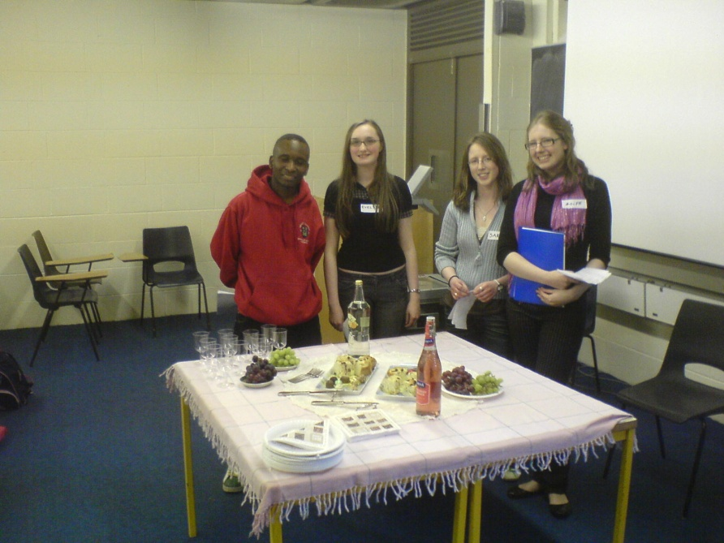
5. Project work
Cycle of projects (1 or 2 per term, 2 – 4 overall)
Designed for collaboration/interactivity
  Information booklet
  Website
  Murder mystery
  Newsletter
  Debate
  Comedy sketches

Slide 8
6. Group-work
Small groups of 3-5 students
Participation, attendance, preparation
Group oral presentations: interactive
Drama, websites, publishing newsletter, tourist guides, etc.
Don’t be shy; try to meet up outside of class/work by internet

Slide 9
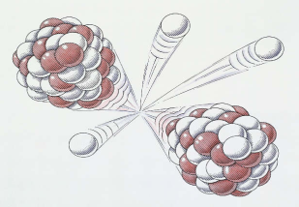
7. Homework
Submit individual written projects in B1 & B2 classes
Not much BUT language learning success is
“a little, often”
Use our multimedia resources
Work on your projects with your classmates
Read news websites, get your email in French/Spanish etc.
Complete your written dossier paying attention to all components (e.g. vocab list) and store in your ELP
Die Geschichte von Ingenieurwesen am Trinity College Dublin
Ingenieurwissenschaften wird seit 1842 in Trinity College Dublin als ein Unterrichtsfach angeboten. Der Fachbereich hat seinen ersten Computer im 1963 bekommen. Viele berühmter Forscher und Erfinder sind aus Trinity gekommen.
Ernest Walton war ein Physiker, der im Trinity Professor seit 1946 war. Walton ist der einzige Ire, der einen Nobelpreis für Wissenschaften zu geschafft hat. Er hat das Atom gespaltet.

Slide 10
8. Portfolio
No set textbooks, but maintain your individual language learning materials/portfolio. Be organised!
Way of organizing, recording, validating your work
Showcase for your work, recording examples of activities you do in class
You can work on an online Language Passport/CV in the language you are learning
You will also get a certificate from us at the end of the year confirming you have completed the module

Slide 11
9. Assessment
50% of your overall Language Modules mark: Continuous assessment derived from your project presentations in 1st and 2nd terms, as well as self-assessment (10%) after each project.
Remaining 50%: End of module in-class test (last week, Hilary Term). The test lasts one hour, and generally includes a dictation and some gap-filling exercises.
In other words, the process of continuous assessment means all the project work you do in class counts towards your final score. So, keep up the good work!

Slide 12
10. Multimedia resources
In rooms 4073 and 4074 in the Arts Building (level 4), 2 x computer resource rooms for language learning
Need to get CLCS membership card (room 4091)
Can watch DVDs, use internet for language learning, use software, use books/dictionaries, learn other languages
e.g. www.busuu.com : English, French, German, Italian, Polish, Portuguese, Russian, Spanish, Turkish

Slide 13

You can ask for a hard copy of the course booklet in the CLCS office
Course booklet & timetable are available onlinewww.tcd.ie/slscs/undergraduate/clcs-language-modules
‘Like’ our Facebook page for regular updates and information on language learning
TCD.languagecentre

Slide 14
CLCS Office contact details
Room 4091, Level 4
Arts Building
Open 10am – 9pm in term-time
clcsinfo@tcd.ie

